Slide 1

How does Dojo work?
  Hello world and analysis

Slide 2

How does Dojo work?
Lesson Content:
    Downloading and installing Dojo
    Hello World analysis
    How does Dojo work?
    Where to find documentation

Slide 3

Downloading and installing dojo
Download the version you need or latest from http://www.dojotoolkit.org
Extract the zip file (a folder like “dojo-release-1.1.1” will be created)‏
Place this folder and it's entire content somewhere inside the web server you will be using (Apache, Tomcat, J2EE server)‏
Rename the folder to “dojo”

Slide 4
Writing Dojo code
Is simply writing HTML+JavaScript and using the dojo JavaScript files which are now on the server.
Dojo is a JavaScript library so knowing JavaScript is useful and necessary.
The most important file is dojo.js which is located in the dojo folder and you will use a <script> tag to load that file.
You will also use .css files from dojo.

Slide 5
Hello, World!
<!DOCTYPE HTML PUBLIC "-//W3C//DTD HTML 4.01//EN"
"http://www.w3.org/TR/html4/strict.dtd">
<html><head>
<title>Dojo: Hello World!</title>
<!-- this is the dojo main file inclusion (do this first) -->
<script type="text/javascript" src="/dojo/dojo/dojo/dojo.js" djConfig="parseOnLoad: true">/script>
<!-- this is needed for theming support -->
<style type="text/css">
@import "/dojo/dojo/dijit/themes/tundra/tundra.css";
@import "/dojo/dojo/dojo/resources/dojo.css";
</style>

Slide 6
Hello, World! (cont. 1)
<!-- this is where we write javascript -->
<script type="text/javascript">
dojo.require("dijit.form.Button");
function helloPressed()‏
{
alert('Click on the Hello World Button');
}
</script>
</head>

Slide 7
Hello, World! (cont. 2)
<body class="tundra">
<!-- a single button which is connected to our helloPressed function -->
<div dojoType="dijit.form.Button" widgetId="helloButton" onClick="helloPressed();">Hello World!
</div>
</body>
</html>
Pretty simple! Notice that this code is browser compatible...

Slide 8
Hello, World! (Summary)
Use the right theme at the <head>
Include dojo.js which is in the dojo folder
Write some JavaScript (usually events)‏
Write some HTML which uses dojo widgets and connects to your java script
You're done!

Slide 9
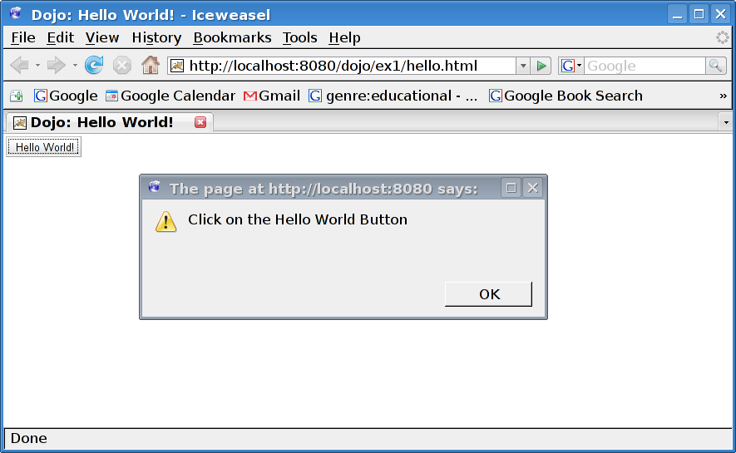
Hello, World! (Result)
And the amazing result...

Slide 10
Hello, World! (Exercise)
Follow the instructions at the exercise chapter and get to a hello world working on your machine
View the source using the browser “view page source” option.
Notice that the source is the same! Dojo is a client side technology. Everything happens at runtime at the client side

Slide 11
ThemeTester (Exercise)‏
Now try putting this URL: http://localhost:8080/dojo/dojo/dijit/themes/themeTester.html
Play around with the demo to get a feel of dojo widget selection and look and feel.
Try out other tests and demos by finding other html files in the dojo distribution

Slide 12
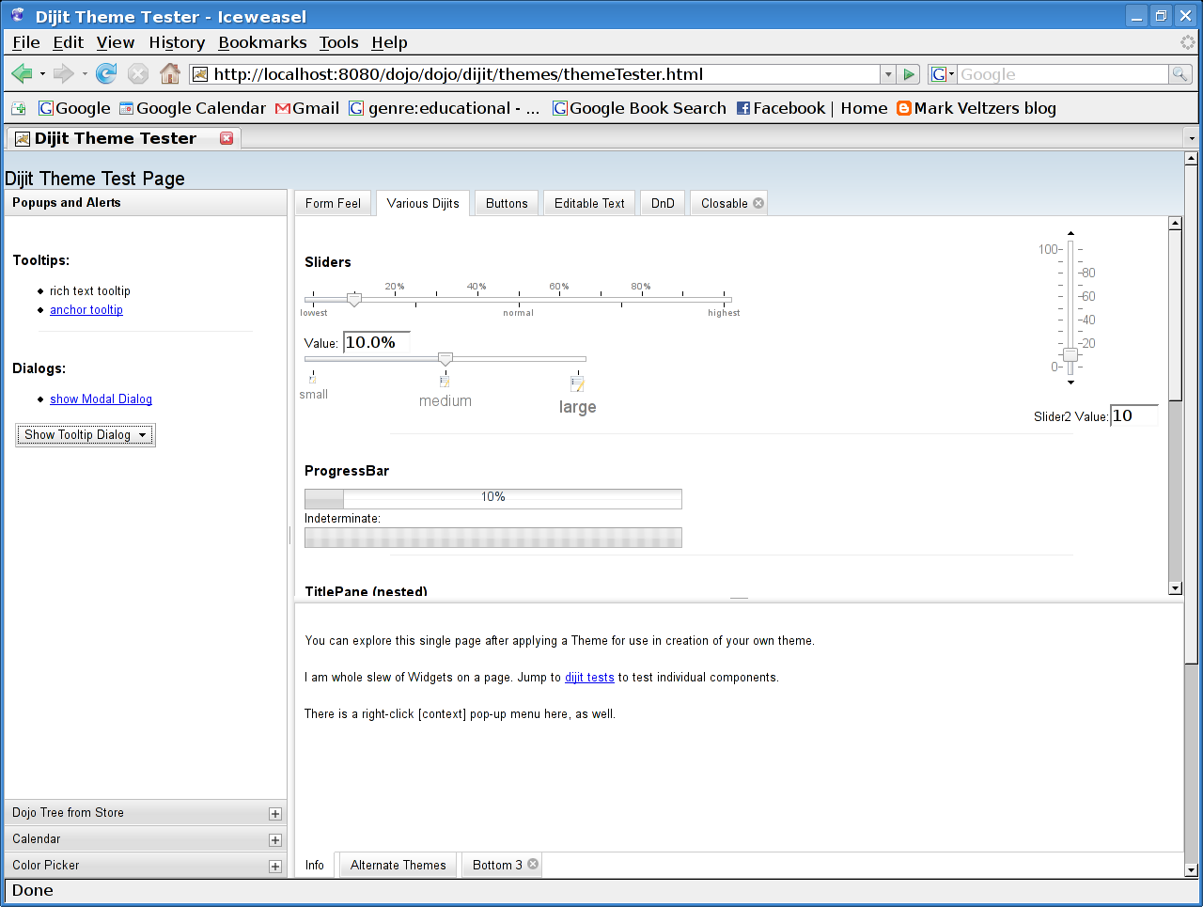
Theme Tester (result)‏
And the amazing result...

Slide 13
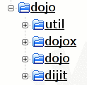
The structure of the tree
Dojo - The core Dojo infrastructure
Util - meaningless
Dojox - extensions which include graphics, widgets, data API and more
dijit - Dojo widgets
Remember:
You don't have to use anything you don't want!

Slide 14
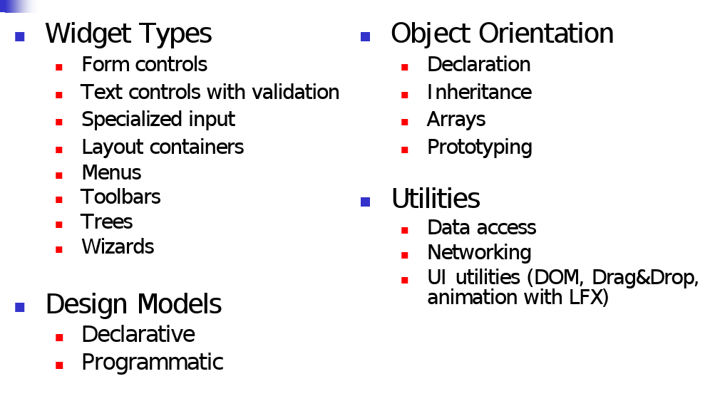
Dojo capabilities

Slide 15
Hello, Tabs!
<!DOCTYPE HTML PUBLIC "-//W3C//DTD HTML 4.01//EN"
"http://www.w3.org/TR/html4/strict.dtd">
<html><head><title>Dojo: Hello tabs!</title>
<!-- this is the dojo main file inclusion (do this first) -->
<script type="text/javascript" src="/dojo/dojo/dojo/dojo.js" djConfig="parseOnLoad: true"></script>
<!-- this is needed for theming support -->
<style type="text/css">
@import "/dojo/dojo/dijit/themes/tundra/tundra.css";
@import "/dojo/dojo/dojo/resources/dojo.css";
</style>

Slide 16
Hello, Tabs! (cont. 1)
<!-- this is where we write javascript -->
<script type="text/javascript">
dojo.require("dijit.layout.TabContainer");
dojo.require("dijit.layout.ContentPane");
</script>
</head>
Notice we require each widget we use! Why ?!?

Slide 17

Hello, Tabs! (cont. 2)
<body class="tundra">
<div dojoType="dijit.layout.TabContainer"
style="width: 400px; height: 400px;">
<div id="kh" dojoType="dijit.layout.ContentPane"
title="Linux kernel hacking" selected="true">
<h1>Linux kernel hacking</h1>
<p>This is a gentle intro to kernel hacking</p>
</div>
Notice we have Dojo code mixed in with regular HTML!

Slide 18
Hello, Tabs! (cont. 3)
<div id="sp" dojoType="dijit.layout.ContentPane"
title="Systems programming">
<h1>Systems programming</h1>
<p>This is a gentle intro to systems programming</p>
</div>
</div>
</body>
</html>
Notice we put Dojo widgets as divs ?!? Why!?!

Slide 19
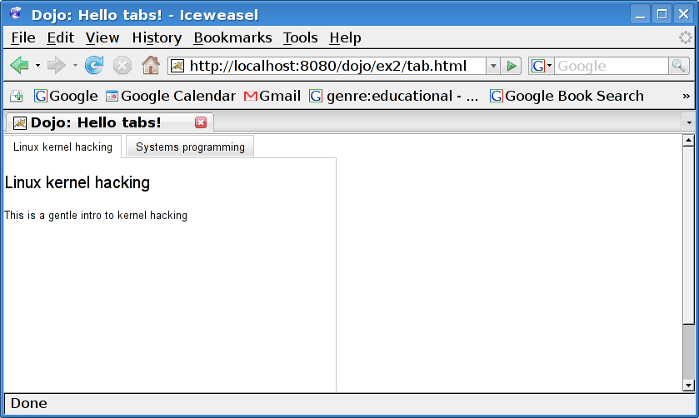
Tab example (result)‏
And the amazing result...

Slide 20
How does Dojo work ?
After the page is loaded, DOJO begins to traverse the DOM tree
It looks for elements that have the dojoType attribute. Such an element is considered to be a DOJO widget.
DOJO then instantiates a JavaScript object for the class identified by the dojoType attribute.

Slide 21
How does Dojo work ? (cont)‏
From the constructor of the class, the widget creates additional elements to render the widget.
Notice that every Dojo widget may trigger the creation of many HTML elements
It does not really matter what HTML element you put the dojoType attribute under, as that element will be replaced.

Slide 22
How does Dojo work ? (cont)‏
Finally, when the widget is fully created, it is made up of two entities:
  A JavaScript object for the widget (generally referred to as the widget object). This object maintains the state and properties of the widget.
  A hierarchy of XHTML DOM elements that render the visual aspects of the widget.

Slide 23
How does Dojo work ? (cont)‏
Technically, the code in dojo.js is what does all of this.
In addition the “djConfig="parseOnLoad: true" tells dojo to do this on load.
There are other ways to tell dojo to do the parsing but this is the most common one
To forget this config option is a common beginners mistake in Dojo

Slide 24
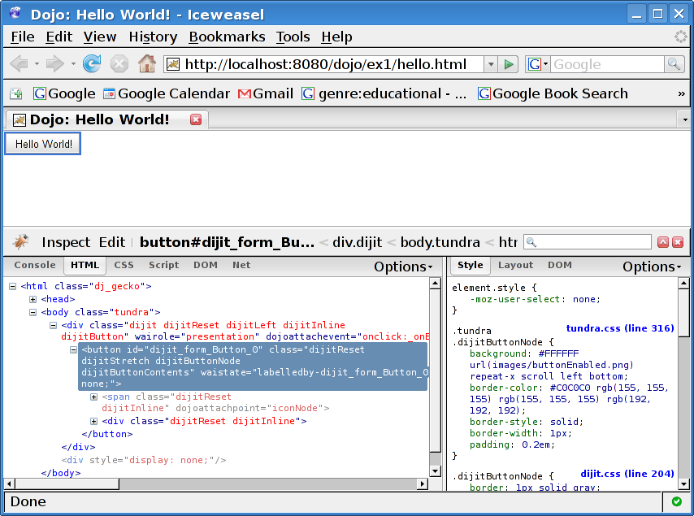
Watch this on firebug!

Slide 25
Working with it all
This means that for each Dojo widget there is a Javascript object and a full hierarchy of DOM nodes.
The object is accessible via dijit.byId([id])‏
If you want to get the DOM nodes then you can access the top one by domNode property of the object.

Slide 26
Working with it all
You can obtain a reference to the DOM element that was used in the page to create the widget using the srcNodeRef property of the widget
This is called the place holder element. Most likely, this element gets hidden. In its place other elements are created to construct the widget

Slide 27
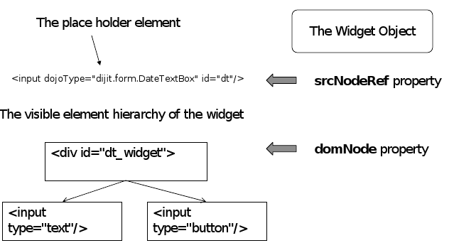
Summing it up

Slide 28
The dojo.byId() function
Is not dijit.byId()!!!
A better version of the document.getElementById() function.
It is shorter to type
Fixes browser compatibility issues
Never use document.getElementById()‏
Did I mention it is not dijit.byId()!!!

Slide 29
Documentation for Dojo
http://www.dojotoolkit.org/ Has “The Book of Dojo”, API reference and many other resources, presentations and links.
Reuven Lerner's series of articles on Linux Journal.
Many web resources.
Use the source Luke!

